Slide 1
Sales Metric Dashboard Analysis
Created by Prachi PALIWAL

Slide 2
Overview
Dataset link -: https://github.com/Prachi005748/CODINGSAMURAI/blob/main/Project%201/Sales_Data_2024.xlsx
Data Cleaning: Data cleaning for the Sales Dataset is essential and involves removing duplicates, fixing spelling errors, handling empty rows, standardizing date formats in the "Order Date" column, and ensuring a uniform monetary format in the "Sales" column. This process ensures data accuracy and integrity, making the dataset suitable for analysis.

Slide 3
aNALYSIS

Slide 4
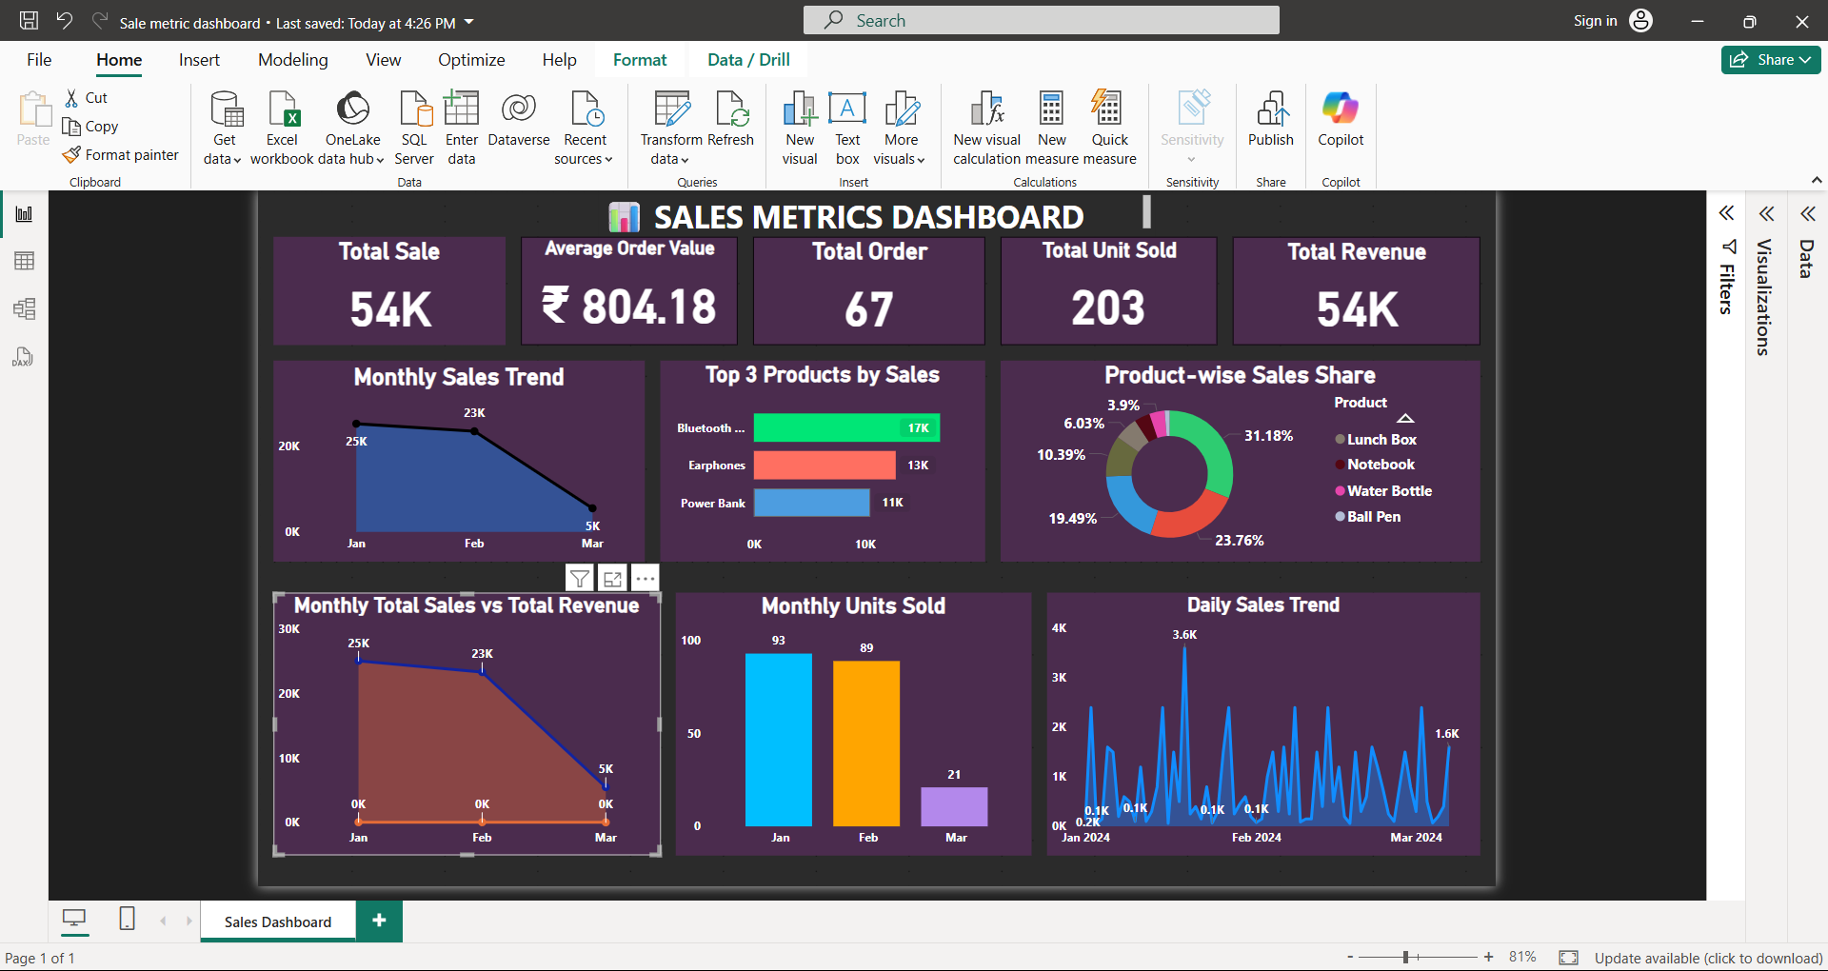
Analysis:
Total Sale: ₹54K worth of sales were made during the analysis period.
Average Order Value: Each order generated an average of ₹804.18 revenue.
Total Orders: 67 customer orders were successfully processed.
Total Units Sold: A total of 203 units were sold across all products.
Total Revenue: The business earned ₹54K in total revenue.

Slide 5
Monthly Sales Trend:
January recorded the highest sales with ₹25K revenue.
February saw a slight dip, generating ₹23K.
March experienced a sharp decline, with only ₹5K in sales.
Overall, there is a downward trend across the three months.

Slide 6
Top 3 product by sales:
Bluetooth Speaker generated the highest sales with ₹16.8K.
Power Bank stood third with ₹10.5K in sales.
Earphones followed with a total of ₹12.8K revenue.

Slide 7
Product – wise sales share:
Bluetooth Speaker held the largest share at 31.18% of total sales.
Earphones contributed 23.76%, securing the second spot.
Power Bank accounted for 19.49% of the sales share.
Top 3 products together made up over 74% of total revenue.

Slide 8
Monthly Total Sales vs Total Revenue:
January recorded the highest sales and revenue, peaking at 25K.
A noticeable decline occurred in March, where both sales and revenue dropped sharply to 5K.
This trend indicates a need to investigate possible reasons behind the declining performance post-February.

Slide 9
Monthly Units Sold:
January saw the highest unit sales with 093 units , followed closely by February at 89 units.
March experienced a steep decline with only 21 units sold.
A strong correlation is visible between units sold and total revenue across months.

Slide 10
Daily Sales Trend:
Sales peaked at ₹ 3.6K on one of the days in January , marking the highest single – day revenue.
Several days reported near – zero revenue , suggesting irregular customer engagement or demand .
The trend highlights key sales spikes and potential off – days ,useful for targeted marketing or operational improvements.

